Slide 1
Polish Musicians
Elementary School Vladimir Nazor Ploče – Croatia
Ingrid & Rebeka Vlaho Oršulić (8.c)
October, 2014

Slide 2
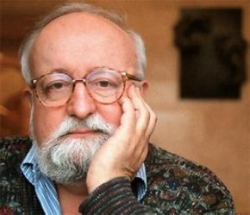
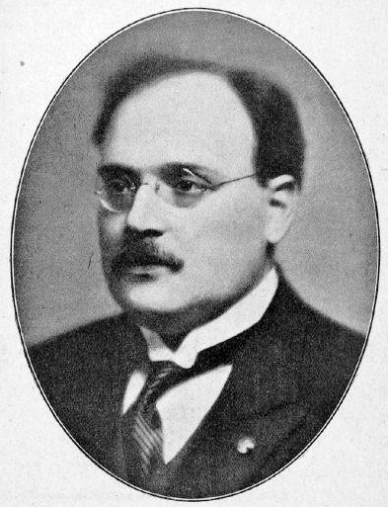
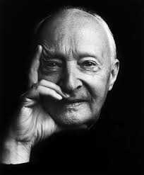
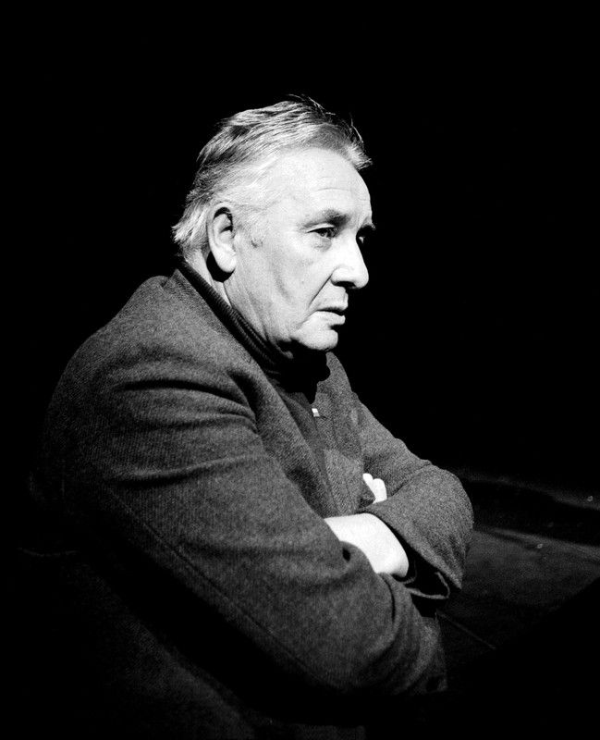
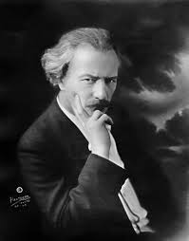
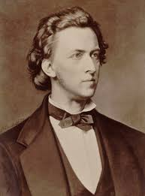
POLISH COMPOSERS
The most popular Polish composers were: Frederic Chopin, Ignacy Yan Paderewski, Krzystaf Panderecki..
Other composers: Henryk Nikolaj Gorecki, Raul Koczalski, Wittolud Lutosawski, Stanislav Moniszko, Ludomir Rozycki and many less known….

Slide 3
Frederic Chopin
Chopin was a Polish composer and virtuoso pianist of the Romantic era, who wrote primarily for the solo piano. Born in the Duchy of Warsaw, he grew up in Warsaw. At the age of 21 he settled in Paris. During the last 18 years of his life, he gave only some 30 public performances. He prefered the more intimate atmosphere of the salon.
All of Chopin's compositions include the piano. Most are for solo piano, although he also wrote two piano concertos, a few chamber pieces, and some songs to Polish lyrics. His major piano works also include sonatas, mazurkas, polonaises, etudes, impromptus, and preludes, some published only after his death. He died in Paris in 1849, probably of tuberculosis.

Slide 4
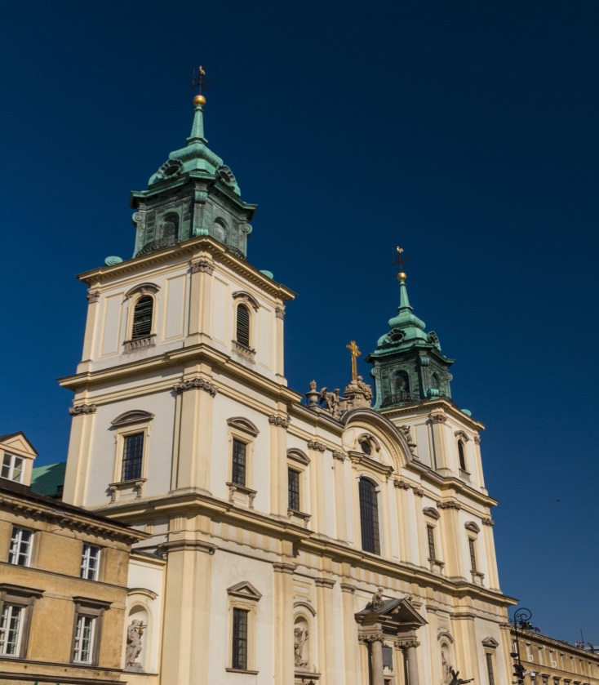
In 1882 an urn with Chopin’s heart was brought from Paris and immured into one of the pillars of the Holy Cross Church in Warsaw. Built in 15 century, it became one of the most notable Baroque churches in Poland’s capital

Slide 5
Ignacy Yan Paderewski
Paderewski was born in the village of Kurilovka. From his early childhood, he was interested in music. In 1880 Paderewski married Antonina Korsakówna. The following year, they discovered that them son was handicapped, soon afterward Antonina died. Paderewski decided to devote himself to music, and in 1881 he went to Berlin to study music composition. His brilliant playing reached to almost extravagant lengths of admiration, and his triumphs were repeated in the United States in 1891. His name at once became synonymous with the highest level of piano virtuosity.

Slide 6
Krzystof Penderecki
Krzystof Penderecki was born in Debic 1933. He studied music at Jagiellonian University and at the Academy of Music in Krakow. Penderecki first worked as a teacher, and than he began his career as a composer. His best known works are his Threnody to the Victims of Hiroshima, St. Luke Passion, Polish Requiem, Anaklasis, four operas... During his life he received a lot of awards.

Slide 7
Henryk Mikolay Gorecki
Henryk Górecki was born on December 6, 1933, in the village of Czernica. The Górecki family lived modestly, though both parents loved music. His father Roman worked at the goods office of a local railway station, but he was an amateur musician, while his mother Otylia played piano. Otylia died when her son was just two years old.

Slide 8
Raul Koczalski
Armand Georg Raoul Koczalski, pianist and composer, fulfilled his promise to become one of the great pianists of all time.
He was taught first by his mother, then by Julian Godomski. He had concerts at the age of 7, and at 9 he was playing in major European cities as a virtuoso. His thousandth concert was given in Leipzig in 1896, and by the age of 12 he had received many awards. No wonder he was Chopin’s favorite Polish student and assistant. Koczalski was considered one of the greatest interpreters of Chopin's music and one of the greatest pianists of his time.

Slide 9
Wittolud Lutosawski
Witold Roman Lutosławski was a Polish composer and orchestral conductor.
During his youth, Lutosławski studied piano and composition in Warsaw. His early works were influenced by Polish folk music. Near the end of his life, he was awarded the Order of the White Eagle, Poland's highest honour.

Slide 10
Stanislav Moniuszko
Stanislaw Moniuszko was a Polish composer, conductor and teacher. He wrote many popular art songs and operas. Moniuszko began private piano lessons with August Freyer in 1827. While living in Berlin, he had an unexpected early success when he set three songs to the words of the Polish national poet Adam Mickiewicz.During his life, Moniuszko was recognised as an important national composer,but after his death, he became revered. From statues, to the names of parks, music competitions, musicians, and institutions the name Stanisław Moniuszko constantly features in Polish society. He has also been featured on stamps, bank notes and other official documents in Poland.

Slide 11
Ludomir Rozycki
Rozicky was a Polish composer and conductor. Together with Mieczysław Karłowicz, Karol Szymanowski and Grzegorz Fitelberg, he made a group of composers known as Young Poland. A son of a professor at the Warsaw Conservatory, he studied piano and composition there and continued his studies in Berlin at the Academy of Music under Engelbert Humperdinck. Rozicky began his musical career as an opera conductor and piano professor. He began to compose while living in Lwów. He later moved to Warsaw where he composed many more works in a number of different genres.

