Slide 1
INFLUENCE OF MUSIC ON PEOPLE
By 8.c:
Marina Markota
Ivana Giljević
Sunčica Matić

Slide 2
WHY DO WE FEEL GOOD WHEN WE LISTEN TO MUSIC?
Dopamine is responsible for the happy feeling that arises in us. Dopamine is a neurotransmitter in the brain, it is a chemical substance and a communication means between neurons.
Dopamine has a similar effect as adrenaline
The chemical formula of dopamine is C8H11NO2

Slide 3
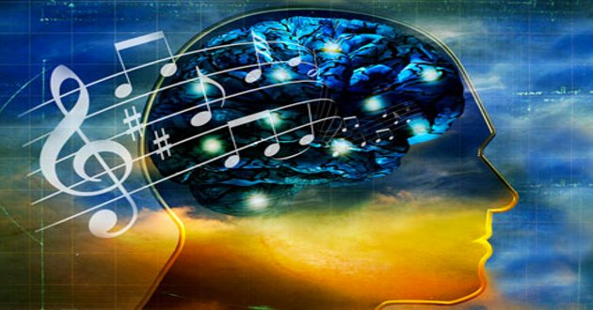
TYPES OF MUSIC AND THEIR EFFECT ON PEOPLE
Classical, pop, rock and Latin sounds have a positive effect on our health and mood
Classical music works well on people who suffer from anxiety and depression, and has positive effects on the immune system. It awakens creativity and memory

Slide 4
Country music has a good effect on people with mental health problems
Heavy metal and techno can have a negative impact on people because that music enhances heart rate and blood pressure

Slide 5
IMPACT OF MUSIC
We often express our feelings with music we listen to. Music has a good effect on our mood, emotional life and brain function
Music has a positive effect on headaches, migraines, stress, concentration and sleep disorders

Slide 6
MUSIC AND HEALTH
Relaxing music works on muscle tension because it relaxes them
Music can help patients to wake from coma
Listening to 45 minutes of relaxing music before bedtime provides restorative sleep.
Daily listening to music for at least an hour reduces back pain by 20%
People who have suffered a stroke are more likely to recover if they listen to music
During exercising, the heart beats more slowly if we listen to music

Slide 7
INFLUENCE OF MUSIC ON BABY
Music positively affects the development of a fetus in the womb; children can recognize the sounds after birth
Mother's singing calms the baby down
Many scientists think that listening to music during pregnancy, especially classical music, improves the intelligence of the child (so-called Mozart effect)

Slide 8
INFLUENCE OF MUSIC ON CHILDREN
It is much easier to learn the alphabet and numbers through songs
Hyperactive children concentrate and participate much better in class with classical music played in the background
Musically literate children learn more easily and concentrate easier than those who are not musically literate

Slide 9
CONCLUSION
Let’s listen to music and sing, because music helps us and our health
It engages our mind not to think about problems and also to relax and enjoy
Music makes life more beautiful!

