Slide 2
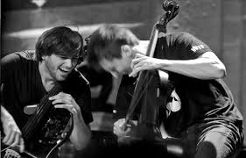
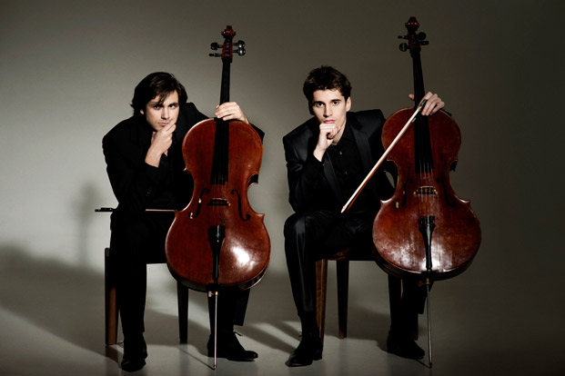
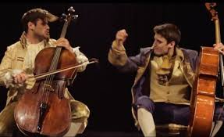
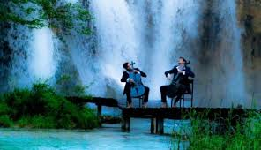
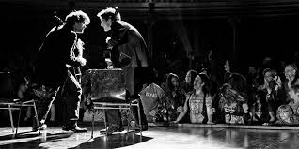
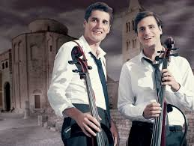
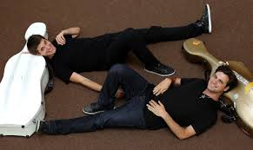
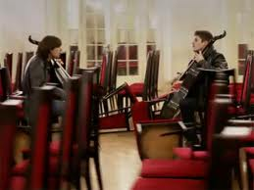

Slide 3
Stjepan Hauser
Stjepan Hauser was born in Pula ,15 June in 1986 in a musical family. Educated in his hometown and in Rijeka. Zagreb, London, and later the United States. Still in his twenties, he’s already performed in more than 40 countries across all the continents. He has won numerous prestigious musical awards together with his colleagues.

Slide 4
Luka Šulić
Luka Šulić was born August 25, 1987, in Maribor, Slovenia. His father was a cellist, and Luka got his musical education in Maribor, Zagreb, Wiena, London. Among series of prestigious international competition, there is a special prize at the VII Lutosławski International Cello Competition in Warsaw (2009).

Slide 5
Before they became partners, the two cellists were sometimes considered rivals, competing against each other in music contests.

Slide 6
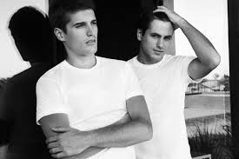
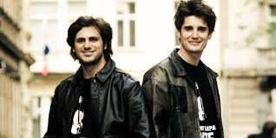
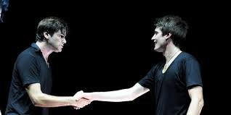
Their mainstream success started when former cello rivals decided to join forces...

Slide 7
They both played their instrument with great love and devotion, and soon realized that real possibilities of cello could not be discovered by playing only classical music.

Slide 8
They had curiosity, courage, passion and determination to show what cello is capable of, but also to prove that rock can be as fulfilling as classical music, that „One song from U2 can have the same emotional power as Chopin's polonaise“.

Slide 9
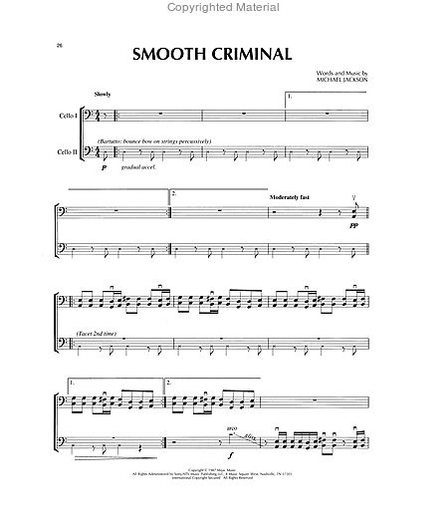
In January 2011, they uploaded a cello version of “Smooth Criminal” by Michael Jackson onto YouTube.

Slide 10
Luka and Stjepan’s success reaches beyond YouTube, they soon became globaly popular and highly appreciated among musicians all over the world.

Slide 11
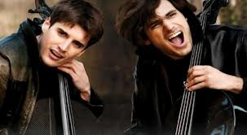
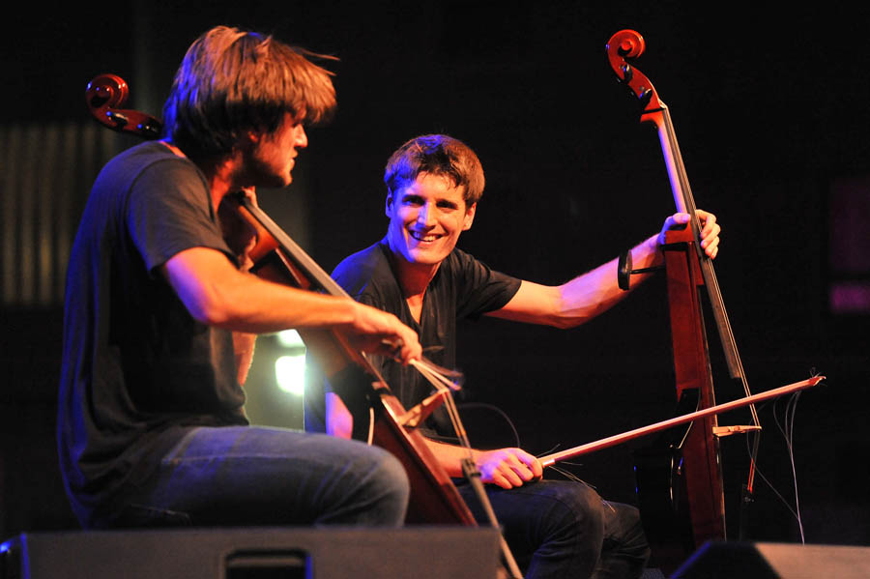
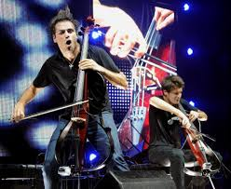
They play in front of thousands of people.With their two instruments, they perform demanding, hard and interesting arrangements,and achieve the intensity of the whole orchestra.

Slide 12
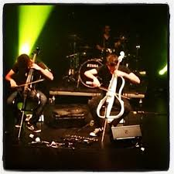
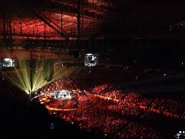
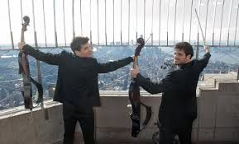
They use all their virtuosity to the maximum extent, with adrenalin and energy which have never been heard before.

Slide 13
Someone said they are a meteor which happens once in a generation.

Slide 14
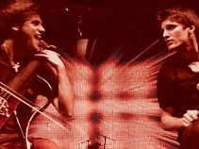
No wonder they are called „Two Croatian geniuses” !

Slide 15
Thank you!

Slide 16
PREPARED BY: Josipa Vlahović
SCHOOL: OŠ Vladimir Nazor, Ploče
TEACHERS: Darka Šutić (English)
Božana Marković (IT)

